Slide 1

Web/iOS Development
Shyne
2014.10.07

Slide 2

Today
Software development life cycle part II
Autolist part II

Slide 3
[Software development life cycle II]

Slide 4
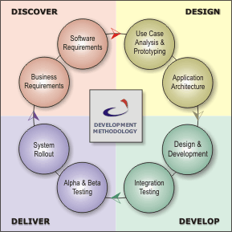
Overview
Describe a process for planning, creating, testing, and deploying an information system

Slide 5
Software development life cycle
You might hear of different methodologies.. And here are a few of them
  Waterfall development
  Prototyping
  Incremental development
  Agile development

Slide 6
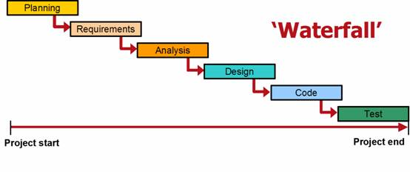
Waterfall model
The waterfall model is a sequential development approach, in which development is seen as flowing steadily downwards (like a waterfall) through several phases

Slide 7
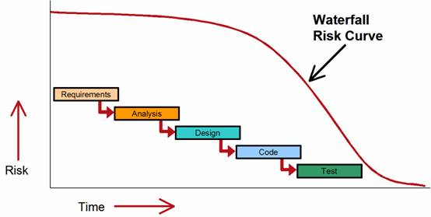
Waterfall model risk profile
The fundamental problem with waterfall processes is that they rely on the assumption that the progress of a software project can be predicted with reasonable accuracy from the outset, and that a reliable completion date can be derived from this.

Slide 8
Prototyping
Software prototyping is the activity of creating prototypes of software applications
Steps
  Identify basic requirements
  Develop initial prototype
  Review
  Revise and enhance the prototype

Slide 9
Incremental development
Break a project into smaller segments and provide more ease-of-change during the development process
Basic principles
  A series of mini-Waterfalls are performed, where all phases of the Waterfall are completed for a small part of a system, before proceeding to the next increment, or
  Overall requirements are defined before proceeding to evolutionary, mini-Waterfall development of individual increments of a system, or
  The initial software concept, requirements analysis, and design of architecture and system core are defined via Waterfall, followed by iterative Prototyping, which culminates in installing the final prototype, a working system

Slide 10
Agile/Scrum
"Agile software development" refers to a group of software development methodologies based on iterative development, where requirements and solutions evolve via collaboration between self-organizing cross-functional teams.
Agile software development uses iterative development as a basis but advocates a lighter and more people-centric viewpoint than traditional approaches.
Agile processes fundamentally incorporate iteration and the continuous feedback that it provides to successively refine and deliver a software system.

Slide 11
Agile/Scrum
Agile
  http://www.youtube.com/watch?v=OJflDE6OaSc
Scrum
  http://www.youtube.com/watch?v=XU0llRltyFM
  http://www.youtube.com/watch?v=WxiuE-1ujCM

Slide 12
[Software design]

Slide 13
Design stage
Use case analysis
Prototyping
Application architecture

Slide 14
Software design guidelines
The design process should not suffer from “tunnel vision”
  A good designer should consider alternative approaches, judging each based on the requirements of the problem, the resources available to do the job.
The design should not reinvent the wheel
  Systems are constructed using a set of design patterns, many of which have likely been encountered before. These patterns should always be chosen as an alternative to reinvention
The design should be structured to accommodate change
Design is not coding, coding is not design
  Even when detailed procedural designs are created for program components, the level of abstraction of the design model is higher than source code.
http://en.wikipedia.org/wiki/Software_design

Slide 15
Design concepts
Abstraction
  Abstraction is the process or result of generalization by reducing the information content of a concept or an observable phenomenon, typically in order to retain only information which is relevant for a particular purpose.
Refinement
  It is the process of elaboration. A hierarchy is developed by decomposing a macroscopic statement of function in a step-wise fashion until programming language statements are reached
Modularity
  Software architecture is divided into components called modules
Software architecture
  It refers to the overall structure of the software and the ways in which that structure provides conceptual integrity for a system.

Slide 16
Design concepts
Data structure
  It is a representation of the logical relationship among individual elements of data
Information hiding
  Modules should be specified and designed so that information contained within a module is inaccessible to other modules that have no need for such information
http://en.wikipedia.org/wiki/Software_design

Slide 17
Design considerations
Compatibility
  The software is able to operate with other products that are designed for interoperability with another product. For example, a piece of software may be backward-compatible with an older version of itself.
Extensibility
  New capabilities can be added to the software without major changes to the underlying architecture.
Fault-tolerance
  The software is resistant to and able to recover from component failure.
Maintainability
  A measure of how easily bug fixes or functional modifications can be accomplished. High maintainability can be the product of modularity and extensibility.

Slide 18
Design considerations
Modularity
  the resulting software comprises well defined, independent components. That leads to better maintainability. The components could be then implemented and tested in isolation before being integrated to form a desired software system. This allows division of work in a software development project.
Reliability
  The software is able to perform a required function under stated conditions for a specified period of time.
Reusability
  the software is able to add further features and modification with slight or no modification.
Robustness - The software is able to operate under stress or tolerate unpredictable or invalid input. For example, it can be designed with a resilience to low memory conditions.

Slide 19
Design considerations
Security
  The software is able to withstand hostile acts and influences.
Usability
  The software user interface must be usable for its target user/audience. Default values for the parameters must be chosen so that they are a good choice for the majority of the users.[3]
Performance
  The software performs its tasks within a user-acceptable time. The software does not consume too much memory.
Portability
  The usability of the same software in different environments.
Scalability
  The software adapts well to increasing data or number of users

Slide 20
Design patterns
A software designer or architect may identify a design problem which has been solved by others before. A template or pattern describing a solution to a common problem is known as a design pattern. The reuse of such patterns can speed up the software development process, having been tested and proven in the past

Slide 21
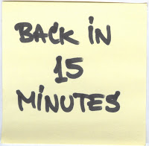

Slide 22
Project

Slide 23
Second day at work
Autolist
  Requirements and feature list from yesterday’s homework.
Design stage
  User stories/scenarios
  Storyboard
  Wireframe

Slide 24
User stories and use cases
User stories/scenarios
  a user story is one or more sentences in the everyday or business language of the end user or user of a system that captures what a user does or needs to do as part of his or her job function (http://en.wikipedia.org/wiki/User_story)
Use cases
  Use case is a “deceptively simple tool” that helps us find and write down all of the ways users interact with the software (http://www.stellman-greene.com/2009/05/03/requirements-101-user-stories-vs-use-cases/)
MRD -> PRD -> technical/functional RD
See http://en.wikipedia.org/wiki/Product_requirements_document

Slide 25
Product requirements document
Business requirements document
Marketing requirements document
MRD -> PRD -> technical/functional RD
See http://en.wikipedia.org/wiki/Product_requirements_document

Slide 26
Storyboard
Storyboards are graphic organizers in the form of illustrations or images displayed in sequence for the purpose of pre-visualizing a motion picture, animation, motion graphic or interactive media sequence
Storyboarding is used in software development as part of identifying the specifications for a particular software. During the specification phase, screens that the software will display are drawn, either on paper or using other specialized software, to illustrate the important steps of the user experience. The storyboard is then modified by the engineers and the client while they decide on their specific needs. The reason why storyboarding is useful during software engineering is that it helps the user understand exactly how the software will work, much better than an abstract description. It is also cheaper to make changes to a storyboard than an implemented piece of software
http://en.wikipedia.org/wiki/Storyboard

Slide 27
Wireframe
A website wireframe, also known as a page schematic or screen blueprint, is a visual guide that represents the skeletal framework of a website
http://en.wikipedia.org/wiki/Website_wireframe
Tools
  https://popapp.in/
  http://www.invisionapp.com/
    http://www.youtube.com/watch?v=Op_KzXwey2o
  http://www.lumzy.com/app/

Slide 28
Tools
https://popapp.in/
http://www.invisionapp.com/
  http://www.youtube.com/watch?v=Op_KzXwey2o
http://www.lumzy.com/app/

Slide 29
Homework
Group discussion – continue on autolist
User story -> use case -> PRD -> storyboard -> wireframe
Pop App or invision
背單字

Slide 30
~ END ~
http://www.alphacamp.tw

